Slide 1
More about JavaScript
INE2720
Web Application Software Development
Essential Materials

Slide 2
Outline – Part B
JavaScript Functions and Events
  Events Handlers
Using Object in JavaScript
  Object-Oriented Programming
  JavaScript Object Model
  Using Built-In objects (Predefined Object)
  Custom Object Types
Error in JavaScript
Exception Handling in JavaScript
INE2720 – Web Application Software Development
All copyrights reserved by C.C. Cheung 2003.

Slide 3
Functions
A function is a block of organized reusable code (a set of statements) for performing a single or related action.
Begins with keyword “function” and the function name and “( … )”
Inside the parentheses
  We can pass parameters to the function
  E.g. function myfuc(arg1, arg2) {…}
  Built-in and user-defined functions
INE2720 – Web Application Software Development
All copyrights reserved by C.C. Cheung 2003.

Slide 4
Built-In Functions
Functions provided by the language and you cannot change them to suit your needs.
Some of the built-in functions in JavaScript are shown here:
  eval - eval(expr)
    eval evaluates the expression or statements
  isFinite
    Determines if a number is finite
  isNaN
    Determines whether a value is “Not a Number”
  parseInt
    Converts string literals to integers, no number → NaN.
  parseFloat
    Finds a floating-point value at the beginning of a string.
INE2720 – Web Application Software Development
All copyrights reserved by C.C. Cheung 2003.

Slide 5
User-Defined Functions
For some functionality, you cannot achieve by only using the built-in functions.
You can define a function as follows
function <function_name> (parameters)
{
// code segments;
}
INE2720 – Web Application Software Development
All copyrights reserved by C.C. Cheung 2003.

Slide 6
Function Declarations
Declaration Syntax
  Functions are declared using the function reserved word
  The return value is not declared, nor are the types of the arguments
  Examples:
function square(x) { return(x * x); }
function factorial(n) {
if (n <= 0) {
return(1);
} else {
return(n * factorial(n - 1));
}
}
INE2720 – Web Application Software Development
All copyrights reserved by C.C. Cheung 2003.

Slide 7
Events
Events are the actions that occur as a result of browser activities or user interactions with the web pages.
  Such as the user performs an action (mouse click or enters data)
  We can validate the data entered by a user in a web form
  Communicate with Java applets and browser plug-ins
INE2720 – Web Application Software Development
All copyrights reserved by C.C. Cheung 2003.

Slide 8
Event Categories
Keyboard and mouse events
  Capturing a mouse event is simple
Load events
  The page first appears on the screen: “Loads”, leaves: “Unloads”, …
Form-related events
  onFocus() refers to placing the cursor into the text input in the form.
Others
  Errors, window resizing.
INE2720 – Web Application Software Development
All copyrights reserved by C.C. Cheung 2003.

Slide 9
Events defined by JavaScript
HTML elements | HTML tags | JavaScript defined events | Description
Link | <a> | click dblClick mouseDown mouseUp mouseOver | Mouse is clicked on a link Mouse is double-clicked on a link Mouse button is pressed Mouse button is released Mouse is moved over a link
Image | <img> | load abort error | Image is loaded into a browser Image loading is abandoned An error occurs during the image loading
Area | <area> | mouseOver mouseOut dblClick | The mouse is moved over an image map area The mouse is moved from image map to outside The mouse is double-clicked on an image map
Form | <form> | submit Reset | The user submits a form The user refreshes a form
… | … | … | …
INE2720 – Web Application Software Development
All copyrights reserved by C.C. Cheung 2003.

Slide 10
Event Handlers
When an event occurs, a code segment is executed in response to a specific event is called “event handler”.
Event handler names are quite similar to the name of events they handle.
E.g the event handler for the “click” event is “onClick”.
<HTMLtag eventhandler=“JavaScript Code”>
INE2720 – Web Application Software Development
All copyrights reserved by C.C. Cheung 2003.

Slide 11
Event Handlers
Event Handlers | Triggered when
onChange | The value of the text field, textarea, or a drop down list is modified
onClick | A link, an image or a form element is clicked once
onDblClick | The element is double-clicked
onMouseDown | The user presses the mouse button
onLoad | A document or an image is loaded
onSubmit | A user submits a form
onReset | The form is reset
onUnLoad | The user closes a document or a frame
onResize | A form is resized by the user
INE2720 – Web Application Software Development
All copyrights reserved by C.C. Cheung 2003.

Slide 12
onClick event Handler
<html>
<head>
<title>onClick Event Handler Example</title>
<script language=“JavaScript”>
function warnUser(){ return confirm(“INE2720 students?”); }
</script>
</head>
<body>
<a href=“reference.html”, onClick=“return warnUser();”>INE2720 Students access only</a>
</body>
</html>
INE2720 – Web Application Software Development
All copyrights reserved by C.C. Cheung 2003.

Slide 13
onLoad event Handler
<html>
<head>
<title>onLoad and onUnload Event Handler Example</title>
</head>
<body onLoad=“alert(‘Welcome User’);”
onUnload=“alert(‘Thanks for visiting the page’);”>
Load and UnLoad event test.
</body>
</html>
INE2720 – Web Application Software Development
All copyrights reserved by C.C. Cheung 2003.

Slide 14
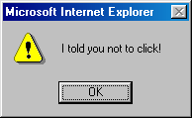
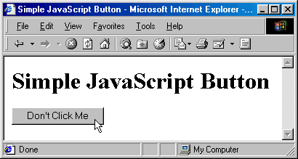
User Events, Form Example
<html><head>
<title>Simple JavaScript Button</title>
<script language=“JavaScript"><!--
function dontClick() {
alert("I told you not to click!");
}
// --></script>
</head>
<body>
<h1>Simple JavaScript Button</h1>
<form>
<input type=“button"
value="Don't Click Me"
onClick="dontClick()">
</form>
</body></html>
INE2720 – Web Application Software Development
All copyrights reserved by C.C. Cheung 2003.

Slide 15
onMouseOver and onMouseOut Event Handlers
<html>
<head>
<title>onMouseOver and onMouseOut event handler</title>
</head>
<body>
<a href=“link.html”
onMouseOver = “status = ‘Now mouse is over the link’; “
onMouseOut = “status = ‘Mouse has moved out’;”>
A Link Page
</a>
</body>
</html>
INE2720 – Web Application Software Development
All copyrights reserved by C.C. Cheung 2003.

Slide 16
Understanding JavaScript Objects
One of the most important features of JavaScript, enables modular programs.
Objects are based on Classes, variables, functions, statements are contained in a structure called class.
Class
varA
varB
varC
varD
FunctionA (…)
FunctionB (…)
FunctionC (…)
FunctionD (…)
INE2720 – Web Application Software Development
All copyrights reserved by C.C. Cheung 2003.

Slide 17
Class and Object
You can instantiate an object from a class by using the constructor function.
JavaScript is said to be an Object-based programming language.
What is property?
  A variable belongs to the object.
What is method?
  It is a function belongs to the object.
  Function-Valued Properties
INE2720 – Web Application Software Development
All copyrights reserved by C.C. Cheung 2003.

Slide 18
Creating Instances of Objects
You can use the “new” operator to create instances of objects of a particular class or object type.
  Variable = new objectType(parameters)
This objectType() is called constructor.
E.g. Date is a predefined object type.
  Assign the current date and time to objA
    objA = new Date()
  Assign another date and time to objB
    objB = new Date(99,23,5) ← 23 May, 99
INE2720 – Web Application Software Development
All copyrights reserved by C.C. Cheung 2003.

Slide 19
Objects and Classes
Fields Can Be Added On-the-Fly
  Adding a new property (field) is a simple matter of assigning a value to one
  If the field doesn’t already exist when you try to assign to it, JavaScript will create it automatically.
  For instance:
var test = new Object();
test.field1 = "Value 1"; // Create field1 property
test.field2 = 7; // Create field2 property
INE2720 – Web Application Software Development
All copyrights reserved by C.C. Cheung 2003.

Slide 20
Objects and Classes – Literal Notation
You Can Use Literal Notation
  You can create objects using a shorthand “literal” notation of the form
{ field1:val1, field2:val2, ... , fieldN:valN }
  For example, the following gives equivalent values to object1 and object2
var object1 = new Object();
var object2 = new Object();
object1.x = 3;
object1.y = 4;
object1.z = 5;
object2 = { x:3, y:4, z:5 };
INE2720 – Web Application Software Development
All copyrights reserved by C.C. Cheung 2003.

Slide 21
Objects and Classes - Constructor
A “Constructor” is Just a Function that Assigns to “this”
  JavaScript does not have an exact equivalent to Java’s class definition
  The closest you get is when you define a function that assigns values to properties in the this reference
  Calling this function using new binds this to a new Object
  For example, following is a simple constructor for a Ship class
function Ship(x, y, speed, direction) {
this.x = x;
this.y = y;
this.speed = speed;
this.direction = direction;
}
INE2720 – Web Application Software Development
All copyrights reserved by C.C. Cheung 2003.

Slide 22
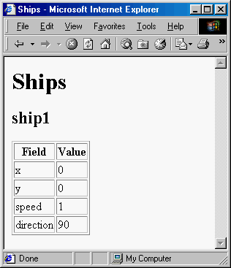
Constructor, Example
var ship1 = new Ship(0, 0, 1, 90);
INE2720 – Web Application Software Development
All copyrights reserved by C.C. Cheung 2003.

Slide 23
Class Methods, Example
function degreesToRadians(degrees) {
return(degrees * Math.PI / 180.0);
}
function move() {
var angle = degreesToRadians(this.direction);
this.x = this.x + this.speed * Math.cos(angle);
this.y = this.y + this.speed * Math.sin(angle);
}
function Ship(x, y, speed, direction) {
this.x = x;
this.y = y;
this.speed = speed;
this.direction = direction;
this.move = move;
}
Consider a version of the Ship class that includes a move method
INE2720 – Web Application Software Development
All copyrights reserved by C.C. Cheung 2003.

Slide 24
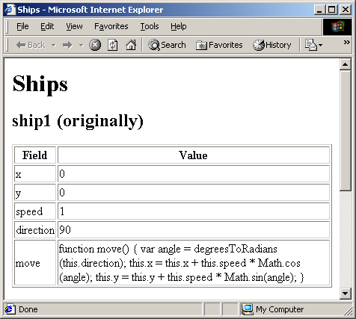
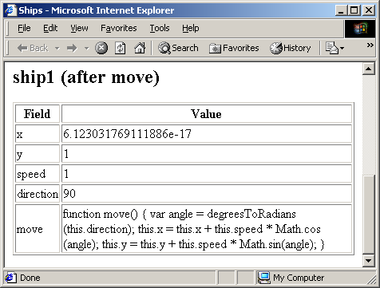
Class Methods, Result
var ship1 = new Ship(0, 0, 1, 90);
ship1.move();
INE2720 – Web Application Software Development
All copyrights reserved by C.C. Cheung 2003.

Slide 25
Objects and Classes - Arrays
Arrays
  For the most part, you can use arrays in JavaScript a lot like Java arrays.
    Here are a few examples:
  var squares = new Array(5);
  for(var i=0; i<squares.length; i++) {
  vals[i] = i * i;
  }
  // Or, in one fell swoop:
  var squares = new Array(0, 1, 4, 9, 16);
  var array1 = new Array("fee", "fie", "fo", "fum");
  // Literal Array notation for creating an array.
  var array2 = [ "fee", "fie", "fo", "fum" ];
  Behind the scenes, however, JavaScript simply represents arrays as objects with numbered fields
    You can access named fields using either object.field or object["field"], but numbered fields only via object[fieldNumber]
INE2720 – Web Application Software Development
All copyrights reserved by C.C. Cheung 2003.

Slide 26
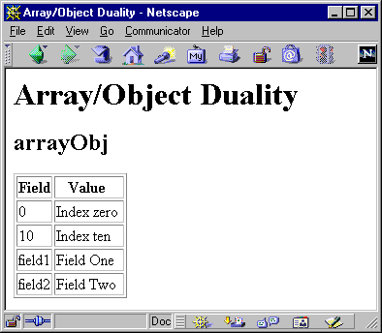
Array, Example
var arrayObj = new Object();
arrayObj[0] = "Index zero";
arrayObj[10] = "Index ten";
arrayObj.field1 = "Field One";
arrayObj["field2"] = "Field Two";
INE2720 – Web Application Software Development
All copyrights reserved by C.C. Cheung 2003.

Slide 27
Build-In JavaScript Objects
Object | Description
Array | Creates new array objects
Boolean | Creates new Boolean objects
Date | Retrieves and manipulates dates and times
Error | Returns run-time error information
Function | Creates new function objects
Math | Contains methods and properties for performing mathematical calculations
Number | Contains methods and properties for manipulating numbers.
String | Contains methods and properties for manipulating text strings
INE2720 – Web Application Software Development
All copyrights reserved by C.C. Cheung 2003.

Slide 28
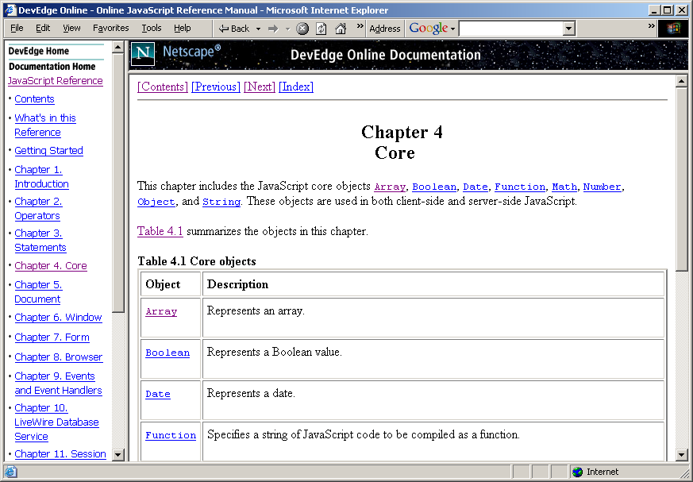
JavaScript References
http://developer.netscape.com/docs/manuals/communicator/jsref/contents.htm
INE2720 – Web Application Software Development
All copyrights reserved by C.C. Cheung 2003.

Slide 29
Error and Exception Handling in JavaScript
While executing your code, runtime exceptions occur.
How can you write error-free scripts?
  The onerror event handler
  The Error object
    http://www.irt.org/xref/Error.htm
  The throw statement
  The try … catch … finally block
Error and Exception are the same.
INE2720 – Web Application Software Development
All copyrights reserved by C.C. Cheung 2003.

Slide 30
onerror Event Handler
Errors may occur due to
  syntax errors
    Syntax is the rules of grammar and spelling
  runtime errors
    The script tries to perform something the system (browser) cannot do.
To capture error event, JavaScript provides the onerror event handler.
The onerror event handler is associated with the window object.
INE2720 – Web Application Software Development
All copyrights reserved by C.C. Cheung 2003.

Slide 31
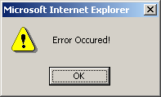
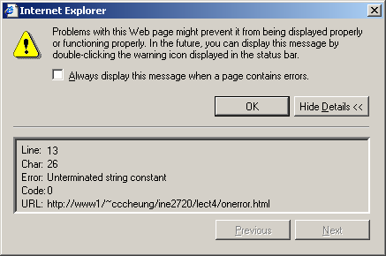
How to use “onerror” event handler?
<html>
<head>
<title>onerror event handler example</title>
<script language=“JavaScript”>
Function errorHandler(){
alert(“an error has ocurred”);
}
window.onerror = errorHandler;
</script>
</head>
<body>
<script language=“JavaScript”>
document.write(“Hello there;
</script>
</body>
</html>
INE2720 – Web Application Software Development
All copyrights reserved by C.C. Cheung 2003.

Slide 32
Exception Handling in JavaScript
An exception is an error generated by the script.
The code that handles an exception is called an exception handler that will catch exceptions.
Normal script flow of control
If an error is occurred,
An exception will be thrown.
The exception is caught
and handled by an
exception handler
INE2720 – Web Application Software Development
All copyrights reserved by C.C. Cheung 2003.

Slide 33
try … catch … finally
try
{
// normal statements
// might result in an error, throw exceptions
}
catch(errorVariable)
{
// statements that execute in the exception event
}
finally
{
// After the execution in the catch or try block,
// the statements in the finally block are executed.
}
INE2720 – Web Application Software Development
All copyrights reserved by C.C. Cheung 2003.

Slide 34
Try … catch … finally example
<script language=“JavaScript”>
try{
document.write(“Try block begins” + “<br>”);
// create a syntax error
eval (“10 + * 5”);
}catch(errVar){
document.write(“Exception caught” + “<br>”);
document.write(“Error name: “ + errVar.name + “<br>”);
document.write(“Error message: “ + errVar.message + “<br>”);
}finally{
document.write(“Finally block reached!”);
}
</script>
INE2720 – Web Application Software Development
All copyrights reserved by C.C. Cheung 2003.

Slide 35

References
Deitel: Chapter 7, 8, 9, 11
CWP: Chapter 24
The End.
Thank you for patience!
INE2720 – Web Application Software Development
All copyrights reserved by C.C. Cheung 2003.

